Slide 1
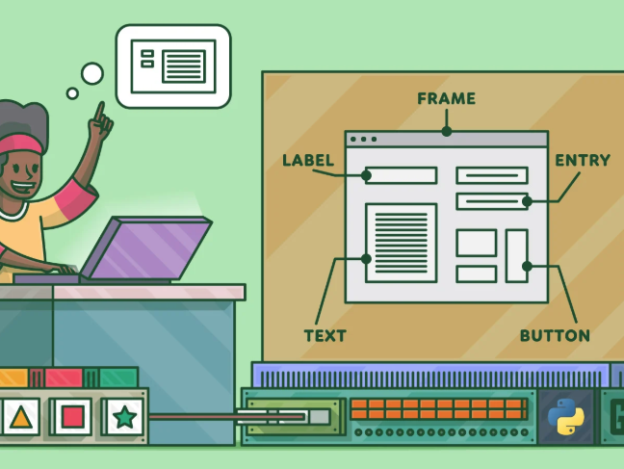
UNIT III GUI PROGRAMMING

Slide 2
SYLLABUS
Introduction to GUI library
Layout management
Events and bindings
Fonts
Colours
Canvas
Widgets (frame, label, button, check box, entry, listbox, message, radiobutton, text, spinbox).

Slide 3
Introduction to GUI
User can interact with an application through controls, and pictures.
User can perform the task just by clicking on relevant control.
Advantages:
It is user friendly
It adds attractions and beauty to any application by adding images, colors, menus, animation etc.
It is possible to simulate the real life applications.
GUI helps to create graphical components like button, radio button, menus, etc, and use them efficiently.

Slide 4
GUI - Tkinter Library
Tkinter is the standard GUI library for Python.
Python when combined with Tkinter provides a fast and easy way to create GUI applications.
Tkinter provides a powerful object-oriented interface to the Tk GUI toolkit.
Creating a GUI application using Tkinter is an easy task. All you need to do is perform the following steps −
Import the Tkinter module.
Create the GUI application main window.
Add one or more of the widgets to the GUI application.
Enter the main event loop to take action against each event triggered by the user.

Slide 5
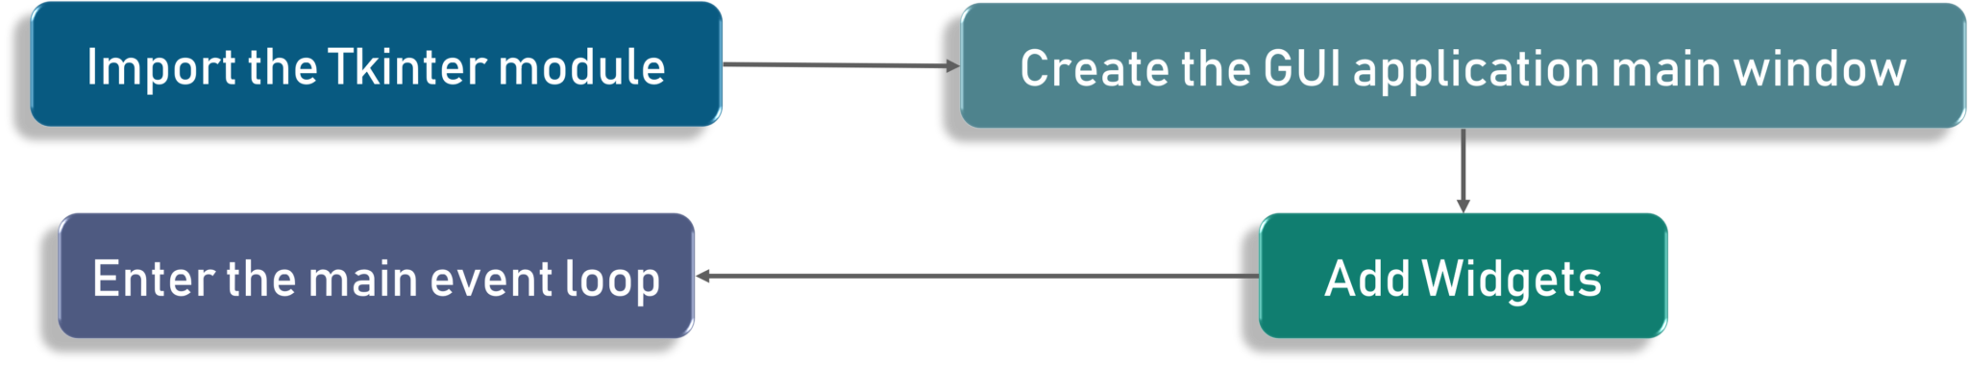
Execution of application in Tkinter

Slide 6
To start out with, we first import the Tkinter model.
Followed by that, we create the main window.
It is in this window that we are performing operations and displaying visuals and everything basically.
Later, we add the widgets and lastly we enter the main event loop.

Slide 7
Introduction to Tkinter Widgets
-Python Tkinter is a package or inbuilt library that is used for GUI programming.
-To develop GUI applications, Tkinter provides widgets that are used to represent in the browser. Tkinter widgets are eventful and represented in the browser, such as textbox, button, etc.
-In Python, Tkinter widgets are standard GUI elements used to handle events through elements like button, frames, labels, etc. In Python, Tkinter provides a small range of widgets that are used in some basic GUI programming, and it also allows us to create specialized widgets as custom widgets.
-Tkinter widgets usually provide various controls in the GUI applications.

Slide 8
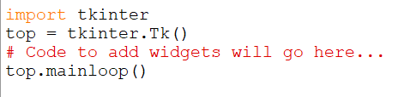
The Root Window
To display the graphical output, the space we create is known as “Root window”
Tk() – to create the window
Mainloop()-
to take action against each event triggered by the user.

Slide 9
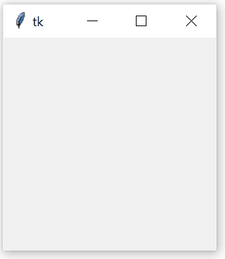
Output

Slide 10
Working with Containers
It is a component used as a place where drawings or widgets can be displayed.
It is a space that displays the output to the user.
Types:
Canvas
Frame

Slide 11
Canvas
It is a container that is generally used to draw shapes like lines, curves, arcs and circles.
To Create Canvas:
C=canvas(root,bg=“blue”,height=300, width=300,cursor=“pencil”)
root- main window
bg= background color
Height, width- window width and height
Cursor- Shape of the cursor
Once the canvas is created , it should be added to the root window
c.pack()

Slide 12
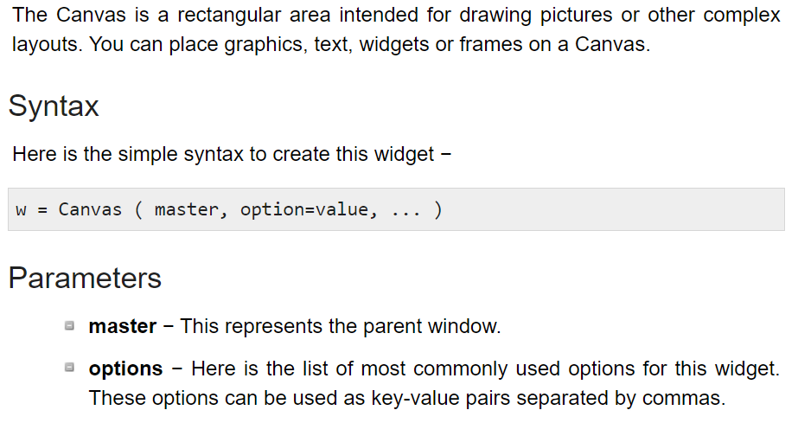

Slide 13
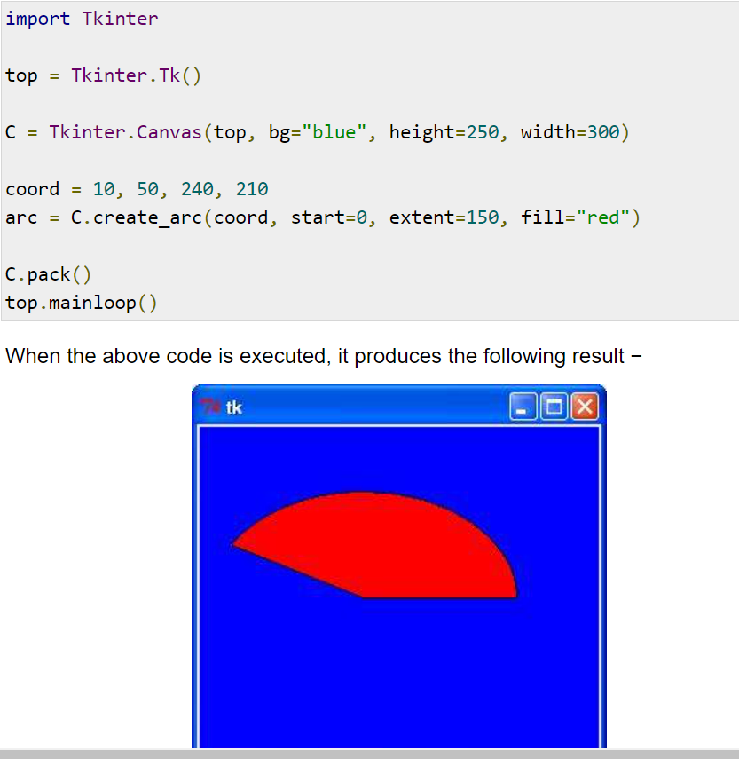

Slide 14
Drawing Shapes
To create a line: create_line()
To create a oval:create_oval()
To create a Rectangle: create_rectangle()
To Create a text : create_text()
To Create an arc: create_arc()
To create a image: create_image()
To create a Polygon: create_polygon()

Slide 15
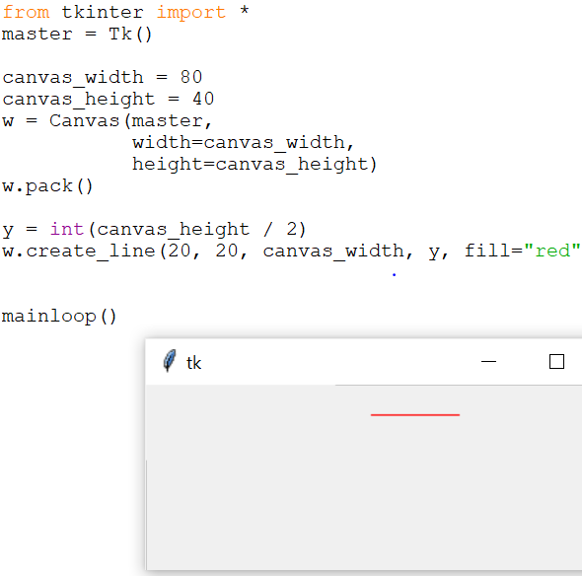
create_line()
Syntax: The method create_line(coords, options) is used to draw a straight line.
The coordinates "coords" are given as four integer numbers: x₁, y₁, x₂, y₂ .
This means that the line goes from the point (x₁, y₁) to the point (x₂, y₂).

Slide 16
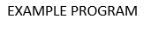
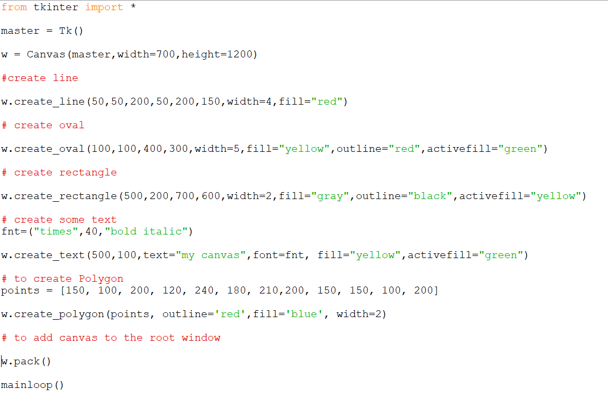

Slide 17
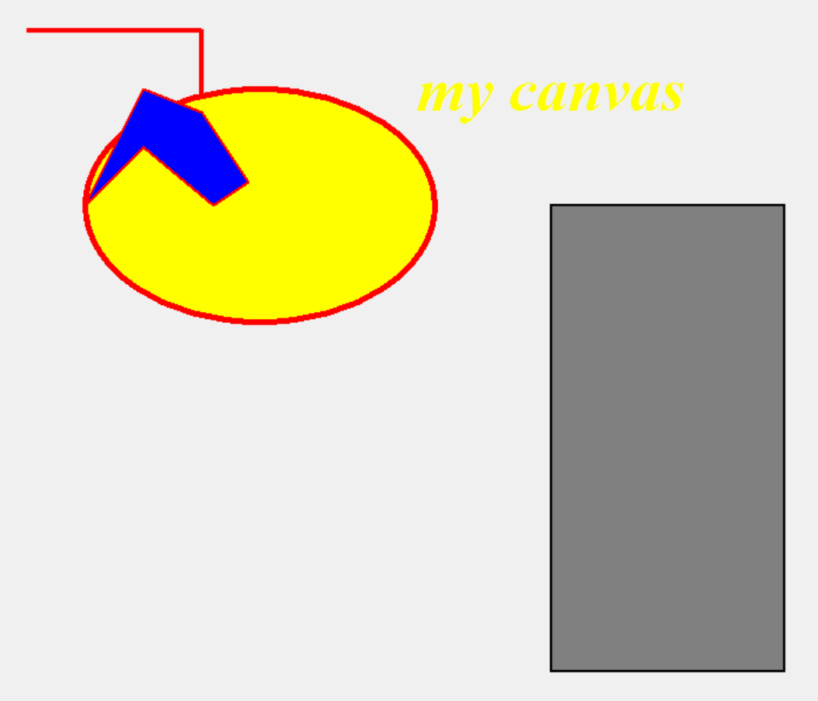
Output

Slide 18
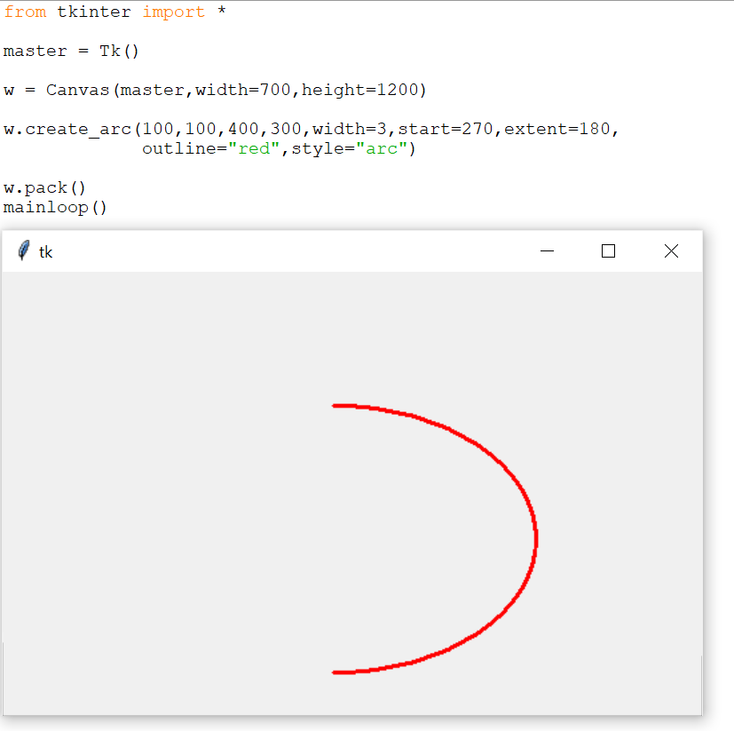
Example- using arc

Slide 19
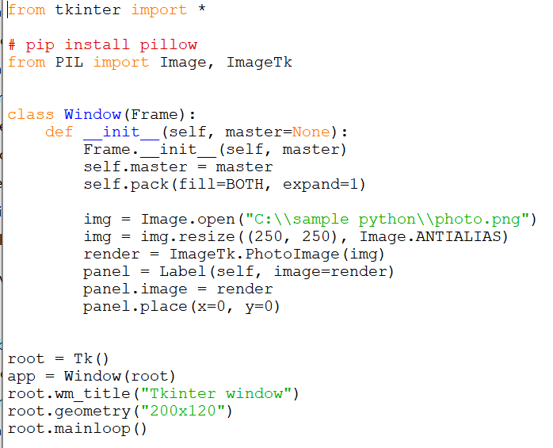

To Display Image

Slide 20
Attributes
bg- Background Color
Fill – fill color
Outline- outline color
Activefill – color to be filled when the mouse is placed
Font – to set the font
Start – arc start angle
Extent – arc drawn from start angle to extent angle
Style -arc/pie slice/ chord
Anchor – position in the window to place the image. (N,NE,NW,S,SE,SW,W,E,CENTER)

Slide 21
Fonts and Colors
Font- a type of displaying letters and numbers.
Syntax:
f= (font name, size, style)
Color:
Name of the color can be used to fetch the color.

Slide 22
Frame
It is a container that is generally used to display widgets like buttons, label, checkbox, menus etc.
The Frame widget is very important for the process of grouping and organizing other widgets in a somehow friendly way. It works like a container, which is responsible for arranging the position of other widgets.
It uses rectangular areas in the screen to organize the layout and to provide padding of these widgets. A frame can also be used as a foundation class to implement complex widgets.
Create Frame:
f=Frame(root, height, width, gb, cursor)
To add frame to the root window
f.pack()

Slide 23
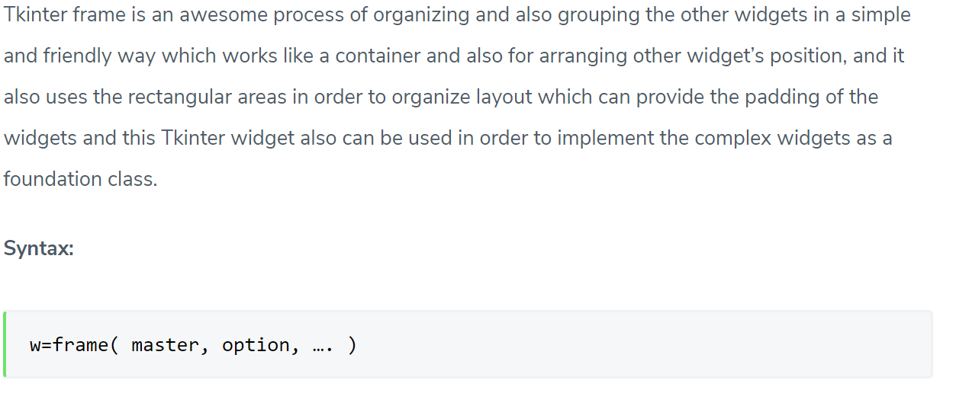

Slide 24
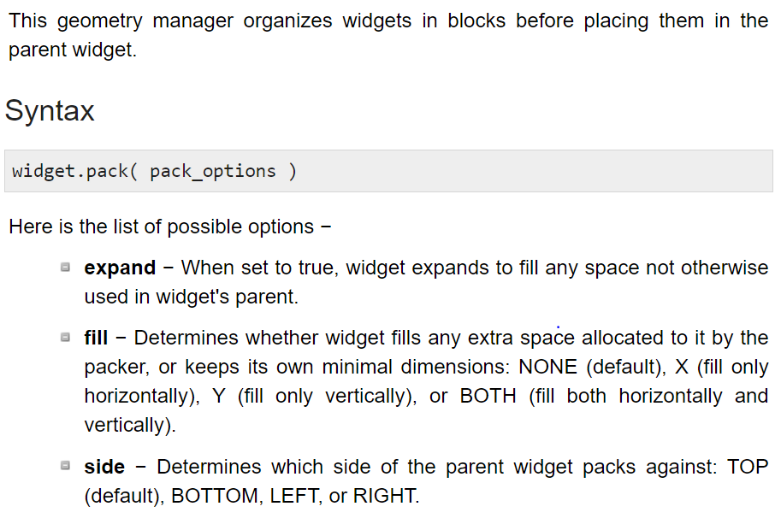
Pack()

Slide 25
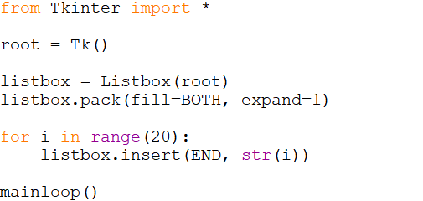
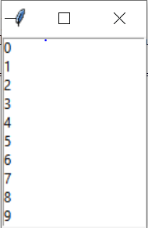
Pack()

Slide 26
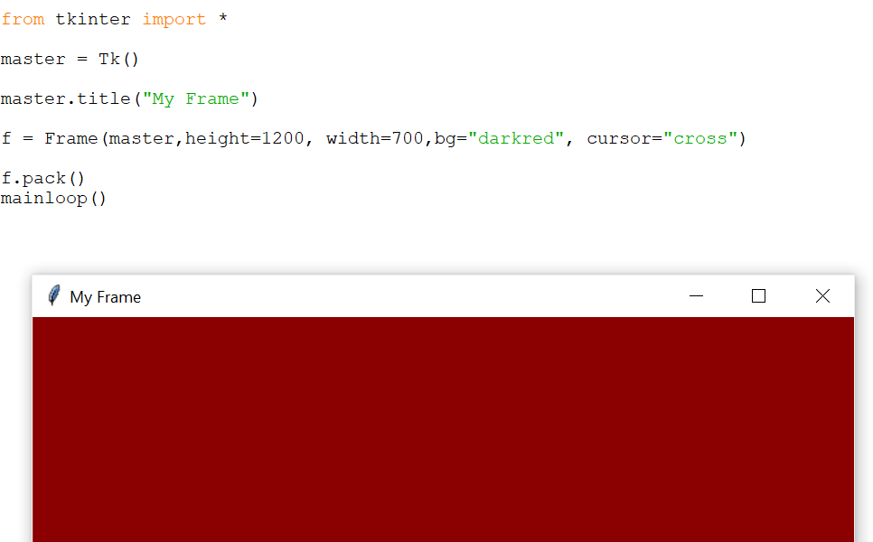
Creation of Frame

Slide 27
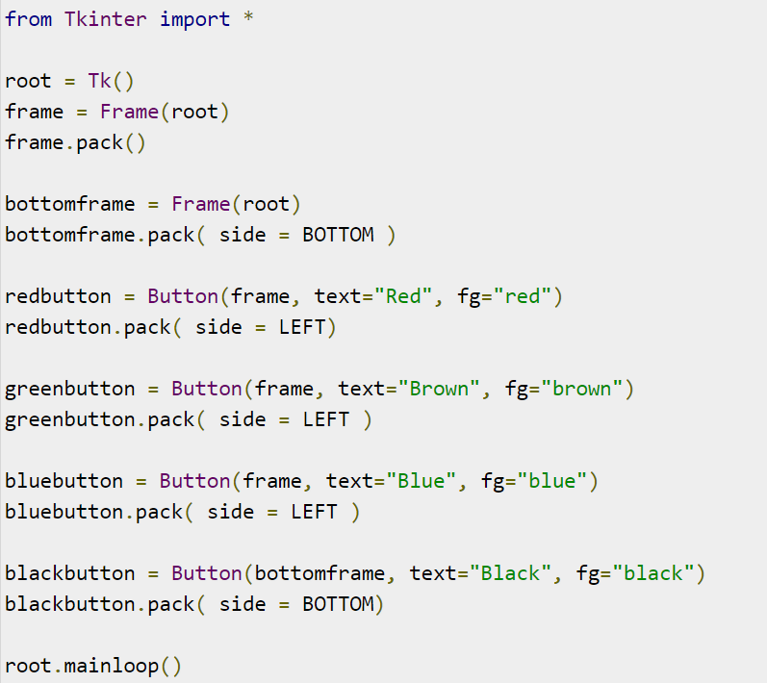

Slide 28
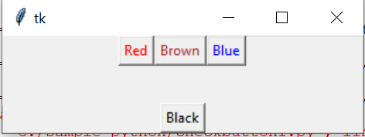
Frame output

Slide 29
Widgets- GUI Controls
A widget is a GUI component that is displayed on the screen and can perform a task as desired by the user.
Create widgets as objects
Label
Button
Message
Text
Checkbutton
Radiobutton
Entry
Listbox
Spinbox

Slide 30
Widgets are something like elements in the HTML. You will find different types of widgets to the different types of elements in the Tkinter.
Let’s see the brief introduction to all of these widgets in the Tkinter.
Check out this diagram for the list of the majorly used Tkinter widgets:

Slide 31
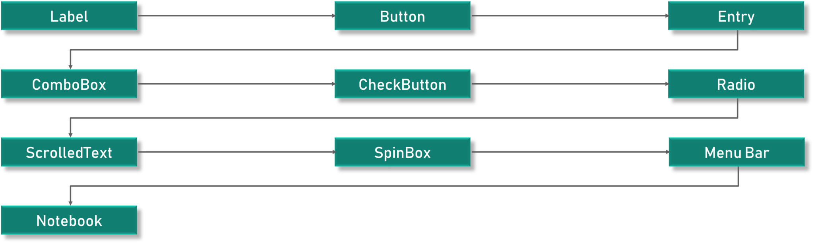

Slide 32
Canvas – Canvas is used to draw shapes in your GUI.
Button – Button widget is used to place the buttons in the Tkinter.
Checkbutton – Checkbutton is used to create the check buttons in your application. Note that you can select more than one option at a time.
Entry – Entry widget is used to create input fields in the GUI.
Frame – Frame is used as containers in the Tkinter.
Label – Label is used to create a single line widgets like text, images etc.
Menu – Menu is used to create menus in the GUI.

Slide 33
Label
A label represents constant text that is displayed in the frame or container.
A label can display one or more lines of text that cannot be modified
labels are used to create texts and images and all of that but it is important to note that it has to be a single line definition only.
Syntax:
lb=Label(Root, options)

Slide 34
S.No. | Option & Description
1 | Activebackground:Background color when the button is under the cursor.
2 | Activeforeground:Foreground color when the button is under the cursor.
3 | Bd:Border width in pixels. Default is 2.
4 | Bg:Normal background color.
5 | Fg:Normal foreground (text) color.
6 | Font:Text font to be used for the button's label.
7 | Height:Height of the button in text lines (for textual buttons) or pixels (for images).
8 | Highlightcolor:The color of the focus highlight when the widget has focus.
9 | Image:Image to be displayed on the button (instead of text).
10 | Width:Width of the button in letters (if displaying text) or pixels (if displaying an image).

Slide 35
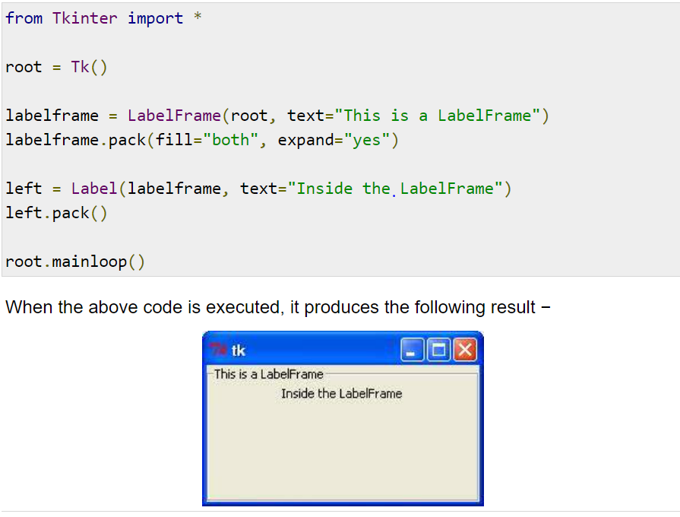
Example for labelframewidget

Slide 36
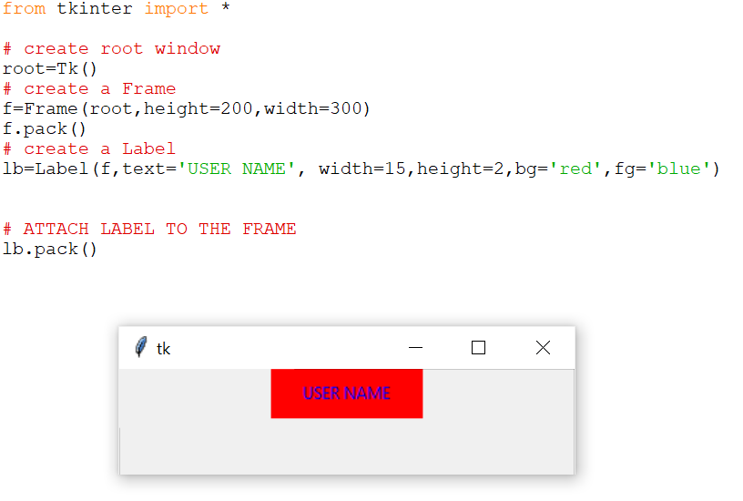
Example:

Slide 37
Button
These buttons can display text or images that convey the purpose of the buttons.
You can attach a function or a method to a button which is called automatically when you click the button.
Syntax:
Parameters
master − This represents the parent window.
options −These options can be used as key-value pairs separated by commas .

Slide 38
S.No. | Option & Description
1 | Activebackground:Background color when the button is under the cursor.
2 | Activeforeground:Foreground color when the button is under the cursor.
3 | Bd:Border width in pixels. Default is 2.
4 | Bg:Normal background color.
5 | Command:Function or method to be called when the button is clicked.
6 | Fg:Normal foreground (text) color.
7 | Font:Text font to be used for the button's label.
8 | Height:Height of the button in text lines (for textual buttons) or pixels (for images).
9 | Highlightcolor:The color of the focus highlight when the widget has focus.
10 | Image:Image to be displayed on the button (instead of text).
11 | Width:Width of the button in letters (if displaying text) or pixels (if displaying an image).

Slide 39
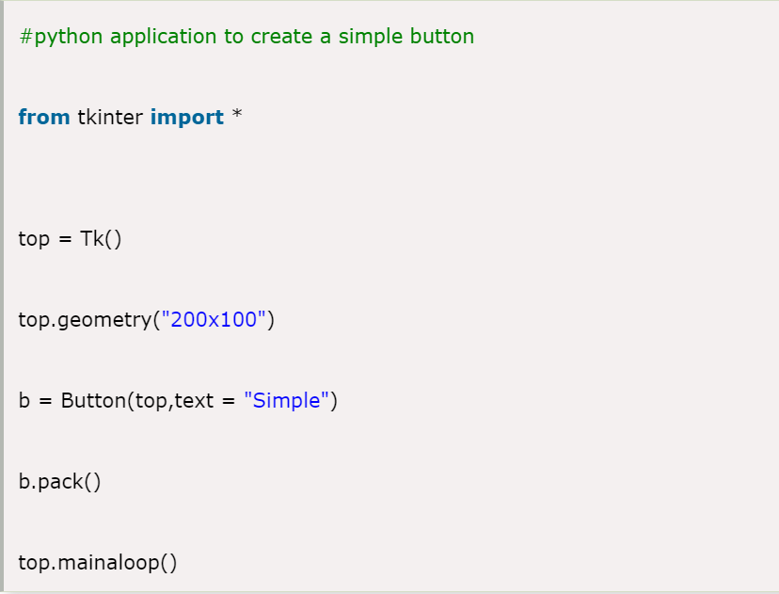
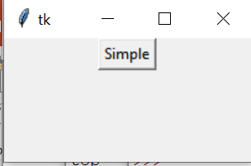

Slide 40
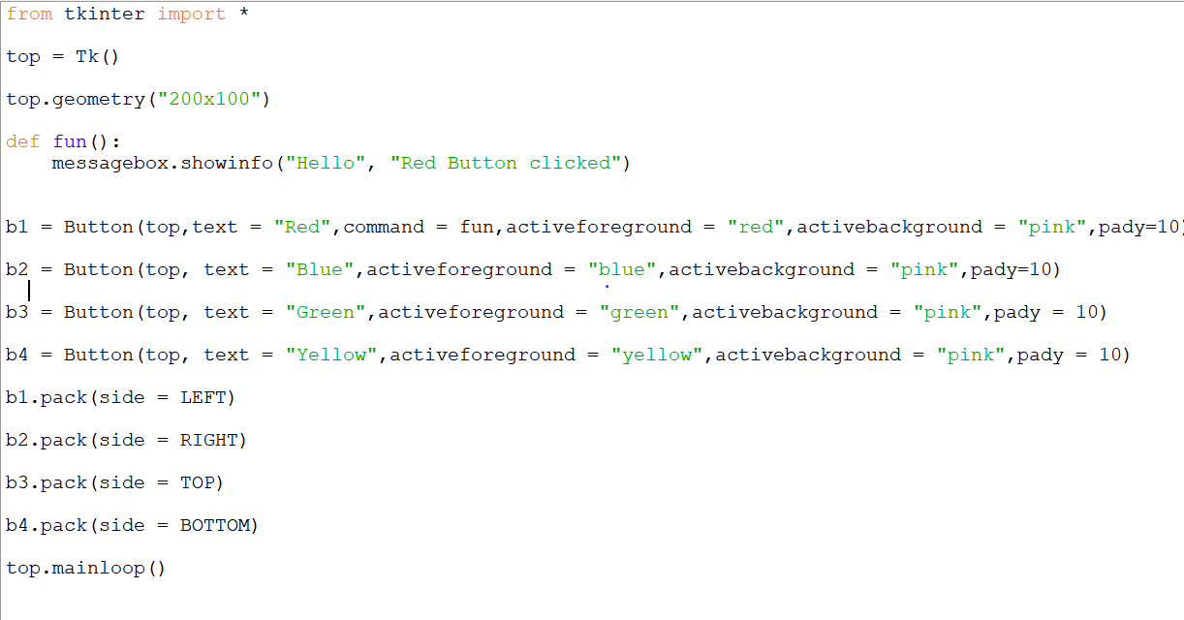
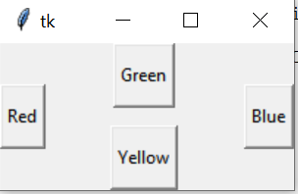

Slide 41
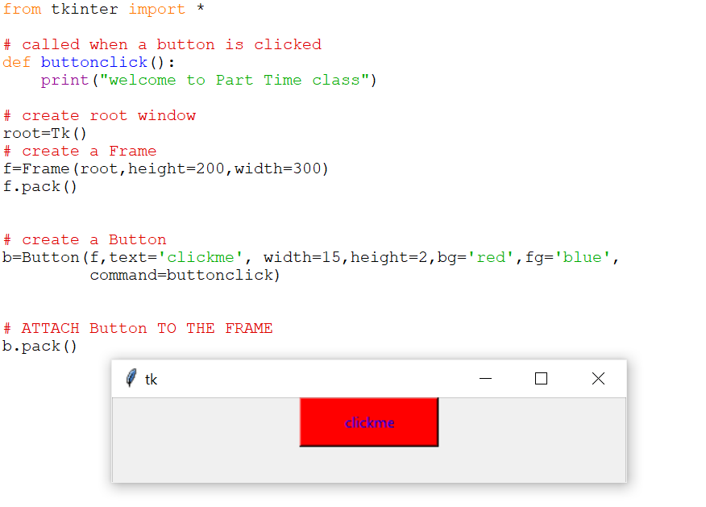
Example

Slide 42
Message
It is similar to label. Used to display multiple lines of text where as a label is used to display a single line of text.
Syntax:
m=Message(Root,option….)

Slide 43
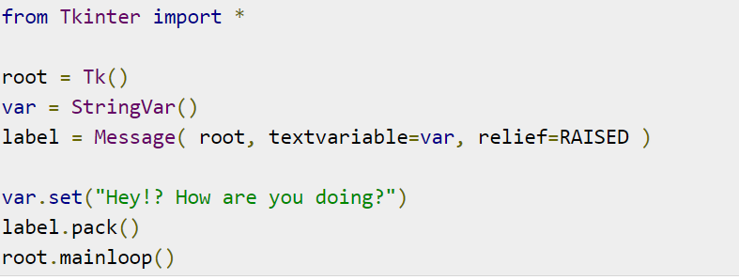
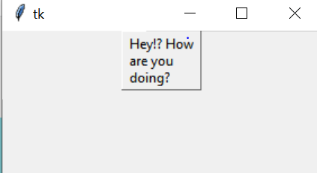
Message example

Slide 44
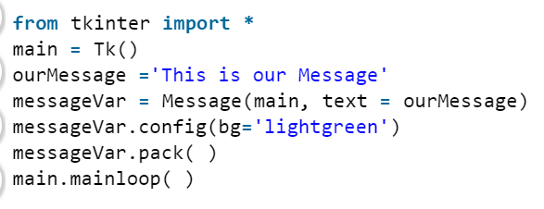
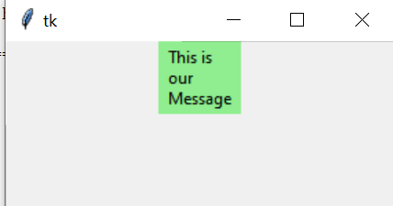
Message Example

Slide 45
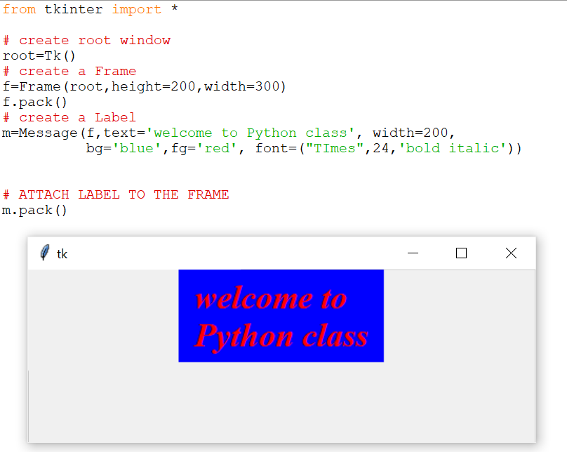
Example

Slide 46
Text Widget
It has several options and can display multiple lines of text in different colors and fonts.
It is possible to insert text, modify text or delete it.
Display Images on in the Text widget.
Syntax:
T=Text( root, options…..)
Methods: insert(), create_image(), tag_add(), configure()

Slide 47
Text widgets provide advanced capabilities that allow you to edit a multiline text and format the way it has to be displayed, such as changing its color and font.
You can also use elegant structures like tabs and marks to locate specific sections of the text, and apply changes to those areas. Moreover, you can embed windows and images in the text because this widget was designed to handle both plain and formatted text.

Slide 48
S.No. | Option & Description
1 | Activebackground:Background color when the button is under the cursor.
2 | Activeforeground:Foreground color when the button is under the cursor.
3 | Bd:Border width in pixels. Default is 2.
4 | Bg:Normal background color.
5 | Fg:Normal foreground (text) color.
6 | Font:Text font to be used for the button's label.
7 | Height:Height of the button in text lines (for textual buttons) or pixels (for images).
8 | Highlightcolor:The color of the focus highlight when the widget has focus.
9 | Image:Image to be displayed on the button (instead of text).
10 | Width:Width of the button in letters (if displaying text) or pixels (if displaying an image).
11 | Wrap: where to cut the line, CHAR,WORD,NONE

Slide 49
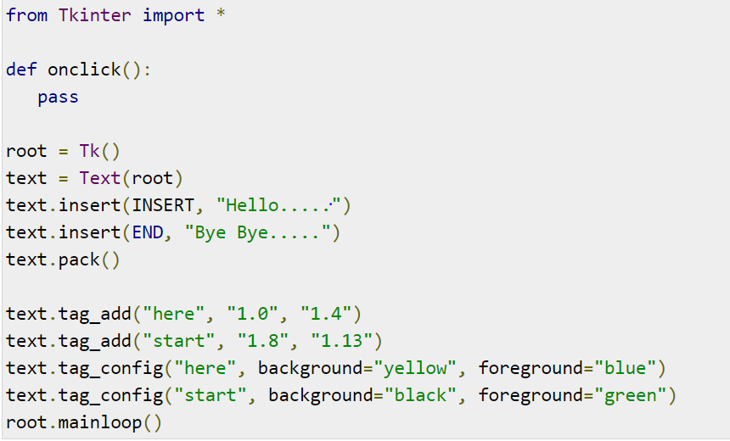
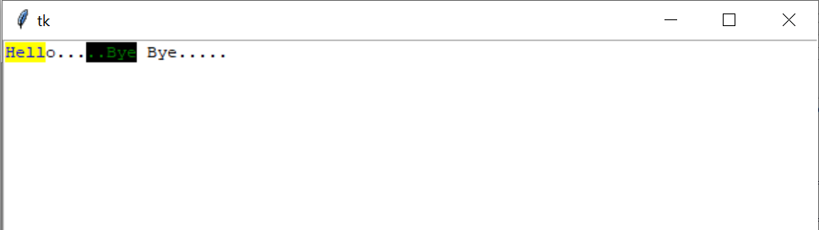

Slide 50
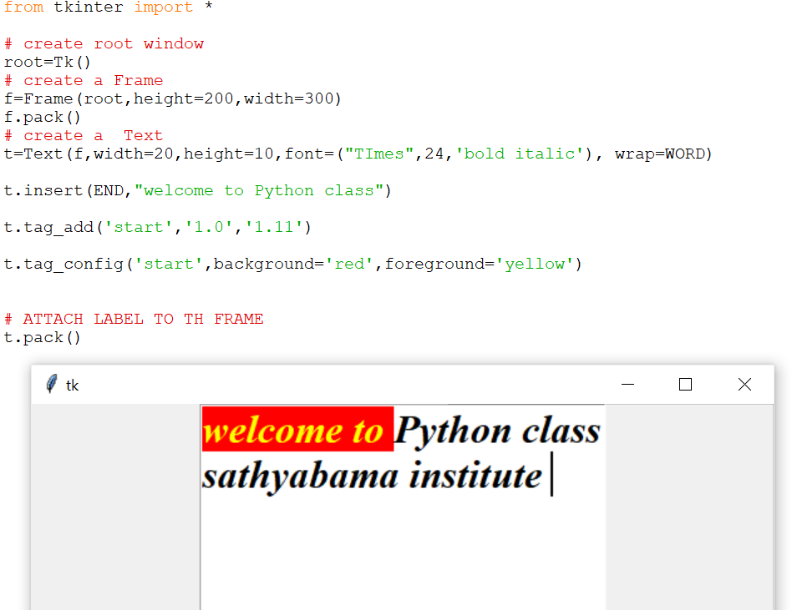
Example

Slide 51
Checkbutton
Useful for the user to select one or more options from the available group of options.
Syntax:
c=Checkbutton(root, option..)
Methods:
IntVar() – to know the state of the check box, whether clicked or not

Slide 52
S.No. | Option & Description
1 | offvalue Normally, a checkbutton's associated control variable will be set to 0 when it is cleared (off). You can supply an alternate value for the off state by setting offvalue to that value.
2 | onvalue: Normally, a checkbutton's associated control variable will be set to 1 when it is set (on). You can supply an alternate value for the on state by setting onvalue to that value.
3 | Bg:Normal background color.
4 | Fg:Normal foreground (text) color.
5 | Font:Text font to be used for the button's label.
6 | Height:Height of the button in text lines (for textual buttons) or pixels (for images).
7 | Highlightcolor:The color of the focus highlight when the widget has focus.
8 | Image:Image to be displayed on the button (instead of text).
9 | Width:Width of the button in letters (if displaying text) or pixels (if displaying an image).

Slide 53
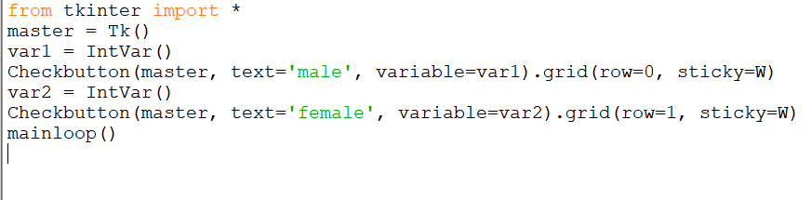
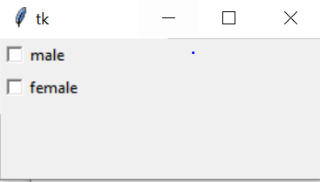
CheckButton Examples

Slide 54
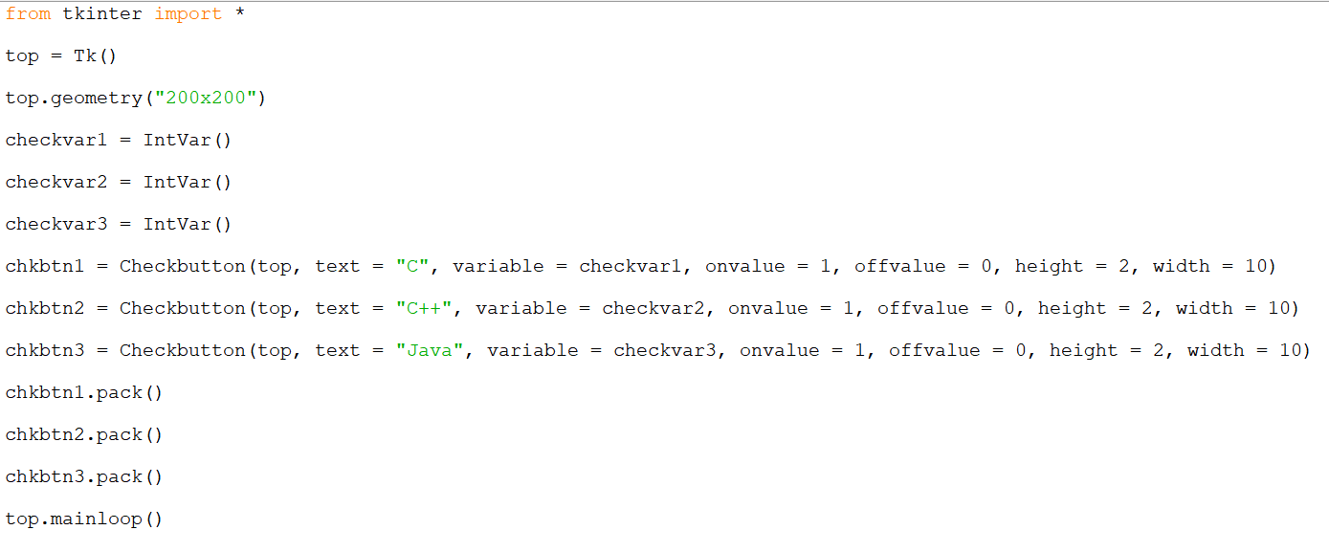
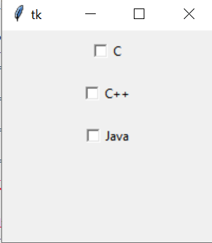

Slide 55
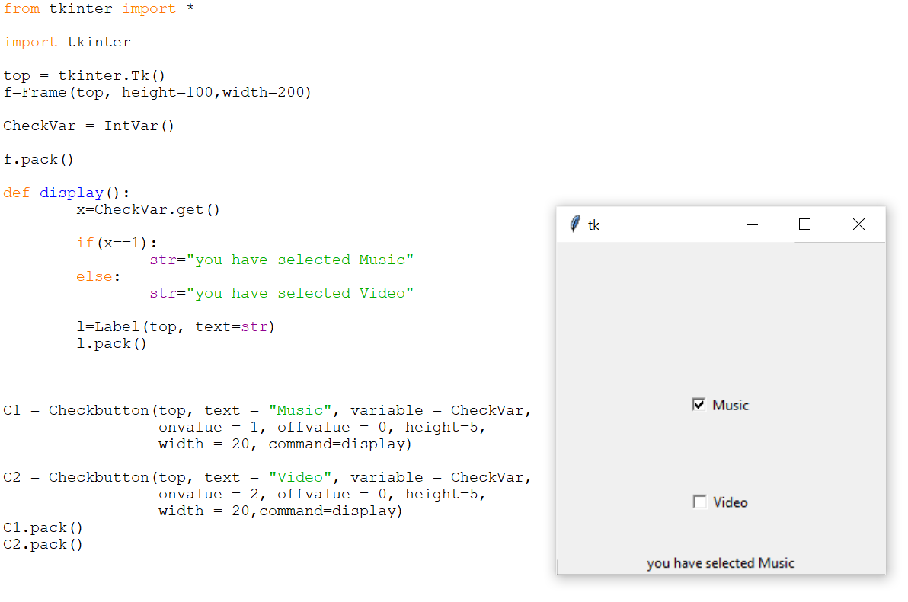
Example

Slide 56
Radiobutton
Similar to check box, but useful to select only one option from a group of available options.
This widget implements a multiple-choice button, which is a way to offer many possible selections to the user and lets user choose only one of them.
In order to implement this functionality, each group of radiobuttons must be associated to the same variable and each one of the buttons must symbolize a single value
Syntax:
R=Radiobutton(root,option)

Slide 57
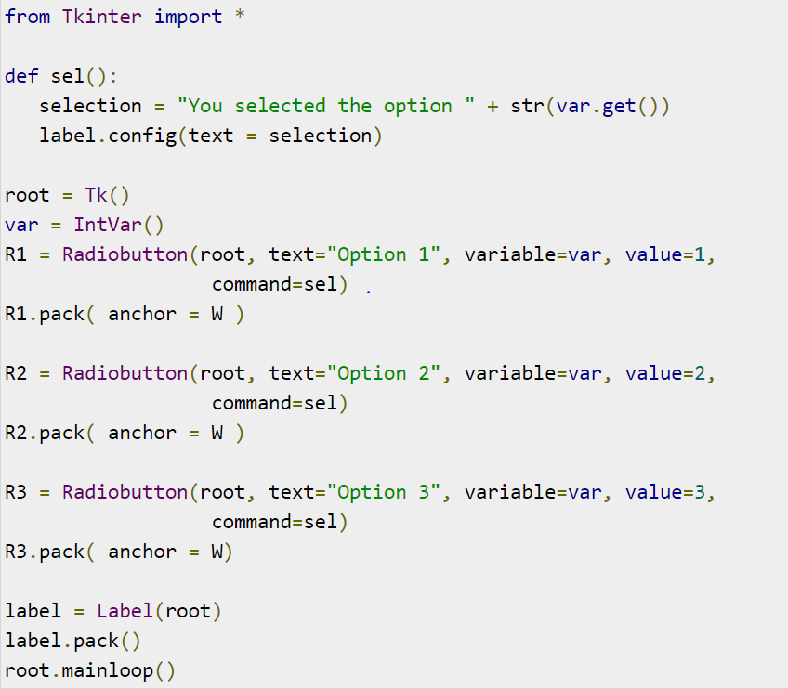

Slide 58
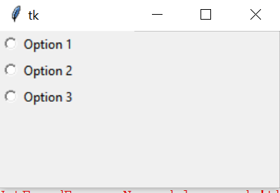
Radiobutton output

Slide 59
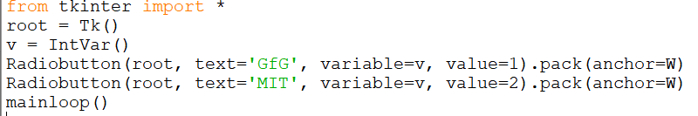
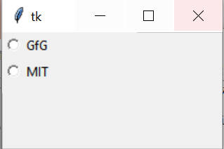
Radiobutton Example

Slide 60
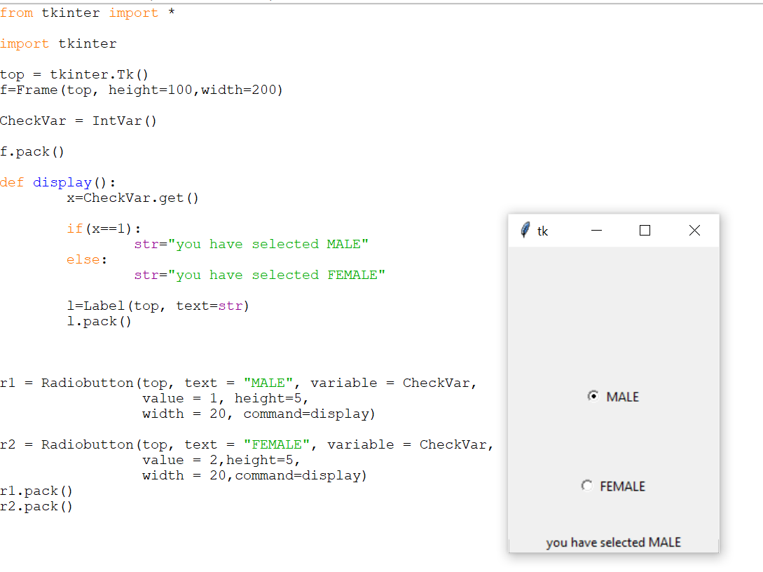
Example

Slide 61
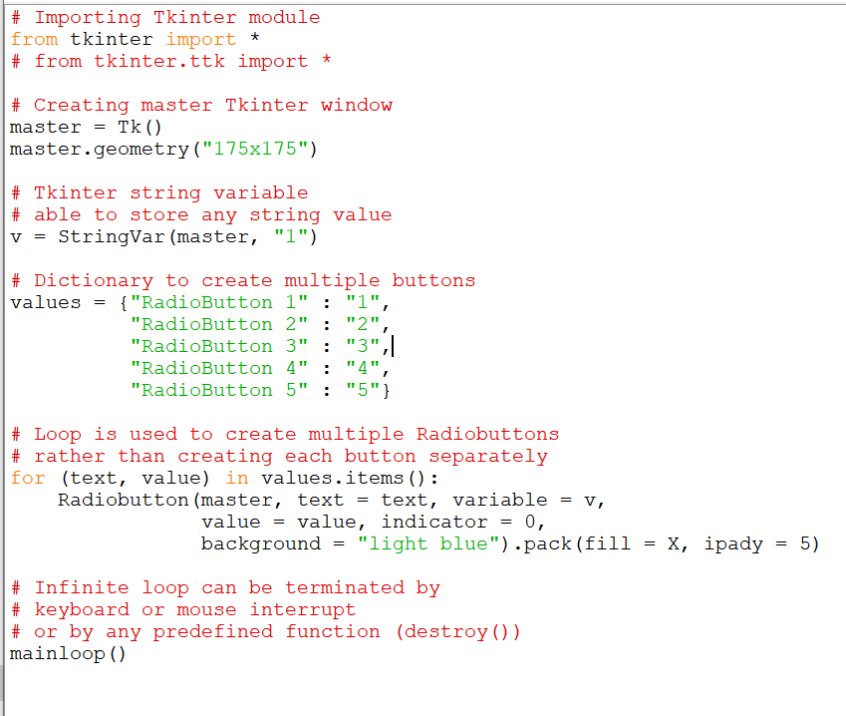
RadioButton Example

Slide 62
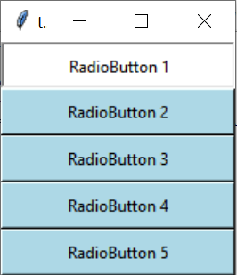

Slide 63
Entry-Control
Used to enter or display a line of text.
In GUI to read input values from user it is used.
The Entry widget is used to accept single-line text strings from a user.
If you want to display multiple lines of text that can be edited, then you should use the Text widget.
If you want to display one or more lines of text that cannot be modified by the user, then you should use the Label widget.
Syntax:
e=Entry(root, option)
Options:
show – to hide the character

Slide 64
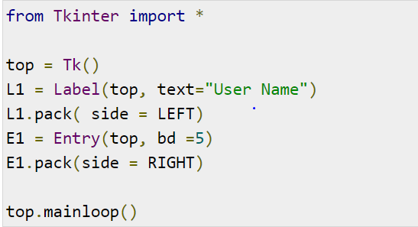
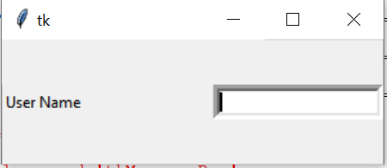
Entry control example

Slide 65
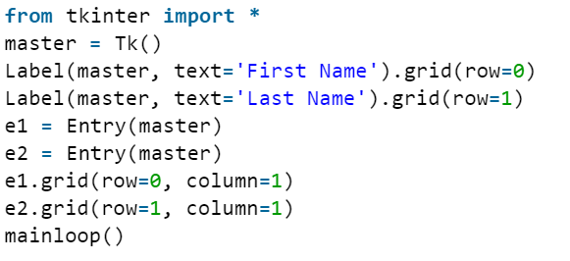

Entry Control Example

Slide 66

Example

Slide 67
Listbox
To display a list of items in a box, so that user can select one or more items.
The Listbox widget is used to display a list of items from which a user can select a number of items.
Syntax:
L=Listbox(root, option)
Option:
activestyle- underline/dotbox/none
Selectmode- BROWSE/SINGLE/MULTIPLE/EXTENDED
Methods:
lb.insert(index,item name) # to insert item to listbox

Slide 68
The ListBox widget is used to display different types of items.
These items must be of the same type of font and having the same font color. The items must also be of Text type.
The user can select one or more items from the given list according to the requirement.

Slide 69



Slide 70


Slide 71

ListBox Output

Slide 72
Spinbox
Allows user to select a value form a set of values
Set of values may be in a range of numbers or a fixed set of strings.
Syntax:
s=Spinbox(root,options)
Example:
S=Spinbox( f, from_=5,to=15,textvariable=val1)

Slide 73



SpinBox Example

Slide 74



SpinBox Example

Slide 75

Example

Slide 76
bind()
To add a function when some item is selected from the list box.
Syntax:
Lb.bind(‘<<ListboxSelect>>’,method name)
Example:
lb.bind(‘<<ListboxSelect>>’, on_select)

Slide 77


Slide 78

Example

Slide 79
Bind()
The binding function is used to deal with the events.
We can bind Python’s Functions and methods to an event as well as we can bind these functions to any particular widget.

Slide 80


Binding mouse movement with tkinter Frame.

Slide 81
Layout Management
To arrange the widgets in the frame is called Layout Management.
Types:
Pack Layout Manager
Grid Layout Manager
Place Layout Manager
Arranging widgets on the screen includes determining the size and position of components.
Widgets can provide size and alignment information to geometry managers, but the geometry managers has always the final say on the positioning and sizing

Slide 82
Pack Layout Manager
Pack is the easiest to use of the three geometry managers of Tk and Tkinter.
Instead of having to declare precisely where a widget should appear on the display screen.
we can declare the positions of widgets with the pack command relative to each other.
Syntax:
Controlobject.Pack(option)

Slide 83
Pack- Options
fill = X/Y/BOTH/NONE
padx ,pady-> how much space should be left around the component horizontally and vertically.
ipadx,ipady ->how much space should be left around the text horizontally and vertically.
side= LEFT /RIGHT

Slide 84


Example- fill option

Slide 85


Padding - option

Slide 86



Slide 87



Slide 88



Slide 89


Side -Option

Slide 90
Place Layout Manager
The Place geometry manager allows you explicitly set the position and size of a window, either in absolute terms, or relative to another window.
The place manager can be accessed through the place method.
It can be applied to all standard widgets.
Syntax: place(x,y,width,height)
X,Y-> position to display
Width, height of the control

Slide 91

Example

Slide 92

Place Geometry Manager Place Geometry Manager

Slide 93


Slide 94


Slide 95

Grid Layout Manager
The Grid geometry manager places the widgets in a 2-dimensional table, which consists of a number of rows and columns.
The position of a widget is defined by a row and a column number.
Widgets with the same column number and different row numbers will be above or below each other.
Syntax: gride(row,column,padx,pady)
Row,column -> position of the grid

Slide 96


Slide 97

Example

Slide 98
Events and Bindings
Tkinter provides a mechanism to let the programmer deal with events.
For each widget, it's possible to bind Python functions and methods to an event.
Syntax: widget.bind(event, handler) If the defined event occurs in the widget,
the "handler" function is called with an event object.

Slide 99

Keyboard Event Handling

Slide 100


Capturing keyboard events

Slide 101

Mouse Event Handling

Slide 102

Example

Slide 103

Example

Slide 104

Events and Binds

Slide 105


Slide 106


Slide 107
Questions
1.Write the Python Program to create simple window.
2. Write a Python Program to create label, entry and button components and arrange the components using Grid Layout.
3. Write a Python Program to validate username and password.
4. Write a Python Program to display the basic shapes.
5.Write the GUI program to create List Box for shopping cart.
6. Write a python Program to create simple calculator.
7. Write a Python Program to add image on the button.
8. Write a Python program to create simple application form.
9. Write a Python program to create check button for selecting multiple hobbies.

Slide 108
Write a Python Program to validate username and password.
Validation :
At least 1 letter between [a-z] and 1 letter between [A-Z].
At least 1 number between [0-9].
At least 1 character from [$#@].
Minimum length 6 characters.
Maximum length 16 characters.

